Slide 1

Team Members
Hady Hossam
512191670
2021893
Hady Ayman
512191669
2021892
Mina Magdy
512191612
2021830
Nabil Mohamed
512191622
2021840

Slide 2
One-Time-Pad Cipher
Definition:
One-time pad cipher is a type of Vignere cipher which includes the following features:
It is an unbreakable cipher.
The key is exactly same as the length of message which is encrypted.
The key is made up of random symbols.
As the name suggests, key is used one time only and never used again for any other message to be encrypted.

Slide 3
One-Time-Pad Cipher
Why is it Unbreakable?
The key is as long as the given message.
The key is truly random and specially auto-generated.
Each key should be used once and destroyed by both sender and receiver.
There should be two copies of key: one with the sender and other with the receiver.
Definition:
One-time pad cipher is a type of Vignere cipher which includes the following features:
It is an unbreakable cipher.
The key is exactly same as the length of message which is encrypted.
The key is made up of random symbols.
As the name suggests, key is used one time only and never used again for any other message to be encrypted.

Slide 4
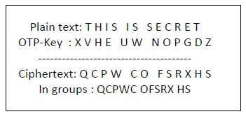
Encryption using One-Time-Pad Cipher
To encrypt a letter, a user needs to write a key underneath the plaintext. The plaintext letter is placed on the top and the key letter on the left. The cross section achieved between two letters is the cipher text

Slide 5
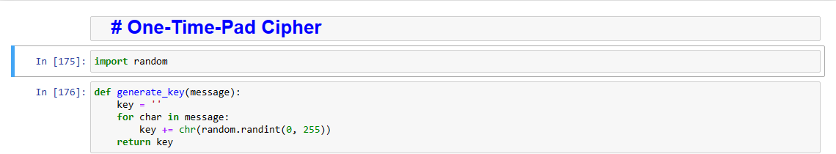
First we need to import random module
the random module is a standard library module that provides functions for generating pseudo-random numbers
The random module is commonly used for various purposes, such as simulations, games, and cryptographic applications.
Then we start making a function to generate the key to be used in encryption
The key is random which means it’s used for only one time and then it’s destroyed
Each time a key is generated is passed to the sender and receiver for one time use only.
The key must be equal the length of the message to be encrypted

Slide 6
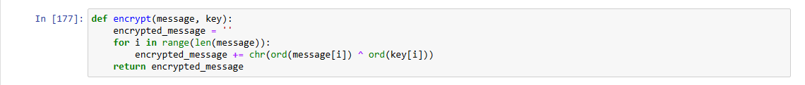
Encryption function
The encryption function accepts the message and the key
To encrypt the message we take each letter from the message and transform it to its corresponding ascii digit and then we do the same operation on the key variable then we preform a XOR operator between them where the operation takes place on the two operands The XOR operation returns 1 for bits that are different and 0 for bits that are the same.
The returned number is then applied to the chr() function to get the corresponding letter.
This function is repeated until the end of the length of the message.

Slide 7
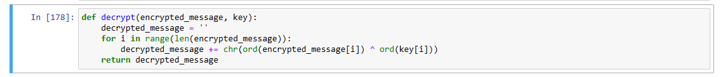
Decryption function
The decryption function accepts the encrypted message and the key
To decrypt the message we take each letter from the message and transform it to its corresponding ascii digit and then we do the same operation on the key variable then we preform an XOR operator between them where the operation takes place on the two operands The XOR operation returns 1 for bits that are different and 0 for bits that are the same.
The returned number is then applied to the chr() function to get the corresponding letter.
This function is repeated until the end of the length of the message.

Slide 8
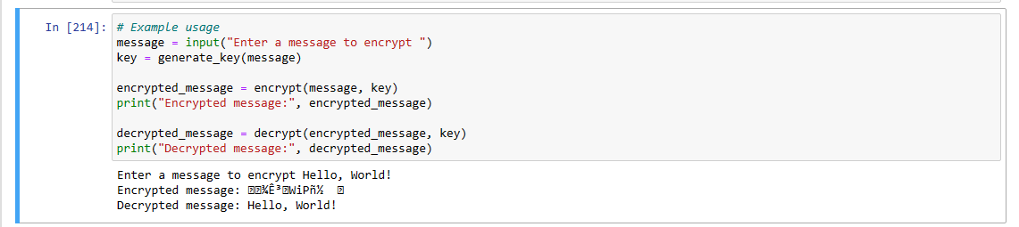
Example Usage
the user enters the desired message to be encrypted then the program generates a key of the same length as the message and then we call the encrypt function and then the decrypt function

Slide 9
The Code

Slide 10
import random def generate_key(message):
key = ''
for char in message:
key += chr(random.randint(0, 255))
return key
def encrypt(message, key):
encrypted_message = ''
for i in range(len(message)):
encrypted_message += chr(ord(message[i]) ^ ord(key[i]))
return encrypted_message
message = input("enter your message ")
key = generate_key(message)
encrypted_message=encrypt(message, key)
print(f"your encrypted message is {encrypted_message}")
print(f"your key is {key}")
def decrypt(encrypted_message, key):
decrypted_message = ''
for i in range(len(encrypted_message)):
decrypted_message += chr(ord(encrypted_message[i]) ^ ord(key[i]))
return decrypted_message
decrypted_message= decrypt(encrypted_message, key)
print (f"your decrypted message is {decrypted_message}")

Slide 11
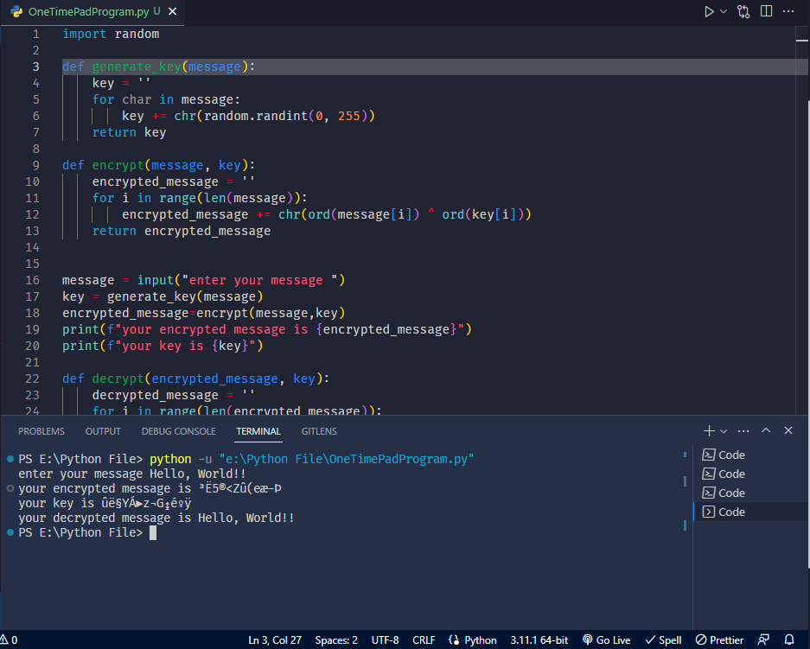
Output

